Slide 1

Unit-2 Array and Control Structure
Object-Oriented Programming using Java
#2104CS203
Prof. Devangi L. Kotak
Darshan Institute Computer Application
devangi.kotak@darshan.ac.in

Slide 2
Control Statements
Control Statements in Java is one of the fundamentals required for Java Programming.
It allows the smooth flow of a program.
A control statement in java is a statement that determines whether the other statements will be executed or not.
Control statements in Java,
If statement
If-else statement
If-else ladder statement
Switch statement

Slide 3
if statement
if statement tests the condition. It executes the if block if condition is true.
public class IfStatementDemo{
public static void main(String[] ar)
{
int a = 10, b = 20;
if( a < b ) {
System.out.println("A is smaller than B");
}
}
}

Slide 4
if-else statement
if-else statement also tests the condition. It executes the if block if condition is true otherwise else block is executed.
public class IfElseStatementDemo{
public static void main(String[] ar)
{
int a = 10, b = 20;
if(a<b) {
System.out.println("A is smaller than B");
}
else {
System.out.println(“A is not smaller than B");
}
}
}

Slide 5
if-else statement
if-else-if ladder statement executes one condition from multiple statements.
int marks = 65;
if (marks < 60) {
System.out.println("fail");
} else if (marks >= 60 && marks < 80) {
System.out.println("B grade");
} else if (marks >= 80 && marks < 90) {
System.out.println("A grade");
} else if (marks >= 90 && marks < 100) {
System.out.println("A+ grade");
} else {
System.out.println("Invalid!");
}

Slide 6
Nested If statement
We can also use if/else if statement inside another if/else if statement, this is known as nested if statement.
int username = Integer.parseInt(args[0]);
int password = Integer.parseInt(args[1]);
double balance = 123456.25;
if(username==1234){
if(password==987654){
System.out.println("Your Balance is ="+balance);
}
else{
System.out.println("Password is invalid");
}
}
else{
System.out.println("Username is invalid");
}

Slide 7
switch statement
switch statement executes one statement from multiple conditions. It is like if-else-if ladder statement.
public class SwitchExampleDemo {
public static void main(String[] args)
{
int number = 20;
switch (number) {
case 10:
System.out.println("10");
break;
case 20:
System.out.println("20");
break;
default:
System.out.println("Not 10 or 20");
}
}
}

Slide 8
Programs to perform (Conditional Statements)
Write a Java program to get a number from the user and print whether it is positive or negative.
Write a program to find maximum no from given 3 no.
The marks obtained by a student in 5 different subjects are input through the keyboard.
The student gets a division as per the following rules:
Percentage above or equals to 60-first division
Percentage between 50 to 59-second division
Percentage between 40 and 49-Third division
Percentage less than 40-fail
Write a program to calculate the division obtained by the student.
Write a Java program that takes a number from the user and displays the name of the weekday accordingly (For example if user enter 1 program should return Monday) .

Slide 9
Looping Statement
Looping in programming languages is a facility for the execution of a set of instructions repeatedly while some condition evaluates to true.
Java provides three ways for executing the loops.
While loop
Do-while loop
For and For-each (will cover this after array)
They all have similar basic functionality but differ in their syntax and condition checking time.

Slide 10
While Loop
while loop is used to iterate a part of the program several times.
while is entry control loop.
If the number of iteration is not fixed, it is recommended to use while loop.
//code will print 1 to 9
public class WhileLoopDemo {
public static void main(String[] args) {
int number = 1;
while(number < 10) {
System.out.println(number);
number++;
}
}
}

Slide 11
Do-while Loop
do-while loop is executed at least once because condition is checked after loop body.
//code will print 1 to 9
public class DoWhileLoopDemo {
public static void main(String[] args) {
int number = 1;
do {
System.out.println(number);
number++;
}while(number < 10) ;
}
}

Slide 12
For Loop
for loop is used to iterate a part of the program several times.
If the number of iteration is fixed, it is recommended to use for loop.
//code will print 1 to 9
public class ForLoopDemo {
public static void main(String[] args)
{
for(int number=1;number<10;number++)
{
System.out.println(number);
}
}
}

Slide 13
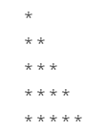
Nested Loop
Loop inside loop is called as Nested loop.
//code will print this pattern
public class ForLoopNested {
public static void main(String[] args)
{
for(int row=1;row<=5;row++)
{
for(int col=1;col<=row;col++)
{
System.out.print(“ * ”);
}
System.out.print(“\n”);
}
}
}

Slide 14
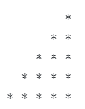

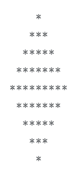
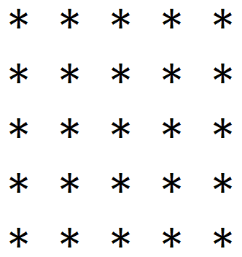


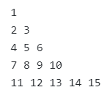


Programs to perform (Looping Statements)
Write a program to print first n odd numbers.
Write a program to check that the given number is prime or not.
Write a program to draw given patterns,

Slide 15
Break statement
When a break statement is encountered inside a loop, the loop is immediately terminated and the program control resumes at the next statement following the loop.
//code will print 1 to 4 followed by “After Loop”
public class BreakDemo{
public static void main(String[] args)
{
for(int number=1;number<10;number++)
{
if(number==5) {
break;
}
System.out.println(number);
}
System.out.println(“After Loop”);
}
}

Slide 16
Continue statement
The continue statement is used in loop control structure when you need to immediately jump to the next iteration of the loop. It can be used with for loop or while loop.
//code will print 1 to 9 but not 5, followed by “After Loop”
public class ContinueDemo {
public static void main(String[] args)
{
for(int number=1;number<10;number++)
{
if(number==5) {
continue;
}
System.out.println(number);
}
System.out.println(“After Loop”);
}
}

Slide 17
Array
An array is a collection of similar type of elements that have continuous memory location and shares a common name.
Syntax : data_type variable_name[] = new type[size_of_array];
Example : int a[] = new int[10];
The data_type specifies the type of the elements that can be stored in an array, like int, float, char etc...
The size_of_array indicates the maximum number of elements that can be stores inside the array.
In the example, data type of an array is int and maximum elements that can be stored in an array are 10.
35
13
28
106
35
42
5
83
97
14
a[0]
a[1]
a[2]
a[3]
a[4]
a[5]
a[6]
a[7]
a[8]
a[9]

Slide 18
Array
Important point about Java array.
An array is derived datatype.
The individual elements of an array is refereed by their index/subscript value.
The index/subscript for an array always begins with 0.
Derived data types are those that are made by using any other data type
35
13
28
106
35
42
5
83
97
14
a[0]
a[1]
a[2]
a[3]
a[4]
a[5]
a[6]
a[7]
a[8]
a[9]

Slide 19
One-Dimensional Array
An array using one subscript to represent the list of elements is called one dimensional array.
A One-dimensional array is essentially a list of like-typed variables.
Array declaration: type var-name[];
Example: int student_marks[];
Above example will represent array with no value (null).
To link student_marks with actual array of integers, we must allocate one using new keyword.
Example: int student_marks[] = new int[20];

Slide 20
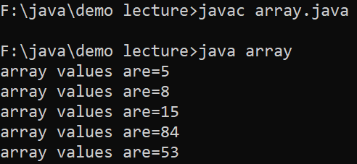
Example (Array)
public class ArrayDemo{
public static void main(String[] args) {
int a[]; // or int[] a
// till now it is null as it does not assigned any memory
a = new int[5]; // here we actually create an array
a[0] = 5;
a[1] = 8;
a[2] = 15;
a[3] = 84;
a[4] = 53;
/* in java we use length property to determine the length
* of an array, unlike c where we used sizeof function */
for (int i = 0; i < a.length; i++) {
System.out.println(“array values are="+a[i]);
}
}
}

Slide 21
Multi-Dimensional Array
In java, multidimensional array is actually array of arrays.
Example: int runPerOver[][] = new int[3][6];
Length field:
If we use length field with multidimensional array, it will return length of first dimension.
Here, if runPerOver.length is accessed it will return 3
Also if runPerOver[0].length is accessed it will be 6
First Over (a[0])
4
0
1
3
6
1
a[0][0]
a[0][1]
a[0][2]
a[0][3]
a[0][4]
a[0][5]
1
1
0
6
0
4
Second Over (a[1])
a[1][0]
a[1][1]
a[1][2]
a[1][3]
a[1][4]
a[1][5]
2
1
1
0
1
1
Third Over (a[2])
a[2][0]
a[2][1]
a[2][2]
a[2][3]
a[2][4]
a[2][5]

Slide 22
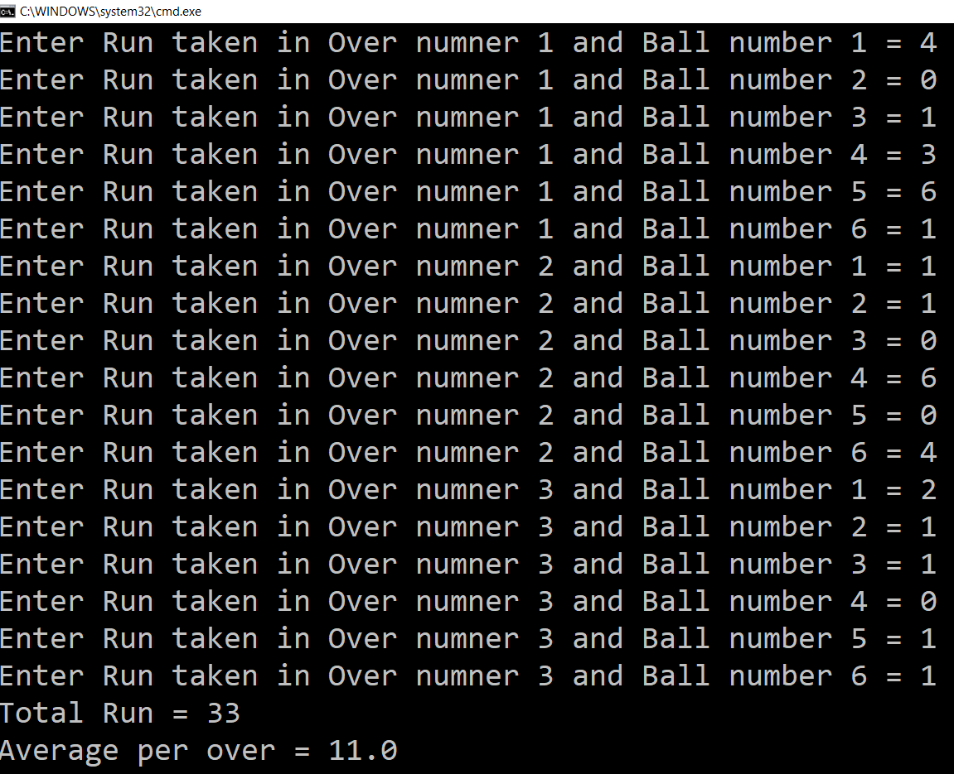
Multi-Dimensional Array (Example)
Scanner s = new Scanner(System.in);
int runPerOver[][] = new int[3][6];
for (int i = 0; i < 3; i++) {
for (int j = 0; j < 6; j++) {
System.out.print("Enter Run taken" +
" in Over number " + (i + 1) +
" and Ball number " + (j + 1) + " = ");
runPerOver[i][j] = s.nextInt();
}
}
int totalRun = 0;
for (int i = 0; i < 3; i++) {
for (int j = 0; j < 6; j++) {
totalRun += runPerOver[i][j];
}
}
double average = totalRun / runPerOver.length;
System.out.println("Total Run = " + totalRun);
System.out.println("Average per over = " + average);

Slide 23
Multi-Dimensional Array (Cont.)
manually allocate different size:
int runPerOver[][] = new int[3][];
runPerOver[0] = new int[6];
runPerOver[1] = new int[7];
runPerOver[2] = new int[6];
initialization:
int runPerOver[][] = {
{0,4,2,1,0,6},
{1,-1,4,1,2,4,0},
{6,4,1,0,2,2},
}
Note : here to specify extra runs (Wide, No Ball etc.. ) negative values are used

Slide 24
Searching in Array
Searching is the process of finding for a specific element in an array.
For example, discovering if a certain element is included in the array or not.
Searching is a common task in computer programming.
Many algorithms and data structures are devoted to searching.
We will discuss two commonly used approaches,
Linear Search
Binary Search

Slide 25
Searching in Array: Linear search
The linear search approach compares the key-element sequentially with each element in the array.
It continues to do so until the key matches an element in the array or the array is finished without a match being found.

Slide 26
Linear search
Steps (Algorithm) of linear search:
Step 1: Traverse the array.
Step 2: Match the key-element with all array elements.
Step 3: If key-element is found, return the index position of the array element.
Step 4: If key-element is not found than print “element is not found”.

Slide 27
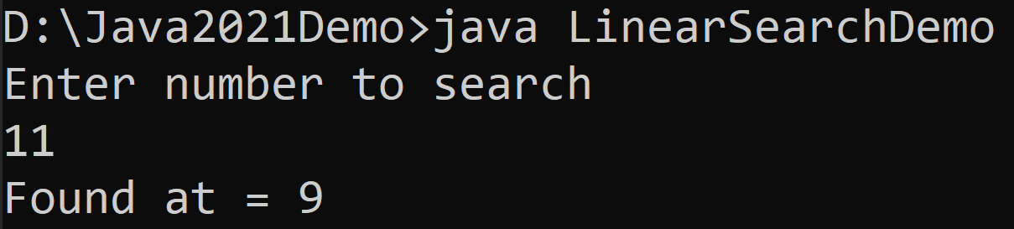
Linear Search
import java.util.Scanner;
public class LinearSearchDemo{
public static void main(String[] args){
int[] myArray = {5,3,6,8,4,6,2,8,9,11};
Scanner sc = new Scanner(System.in);
System.out.println("Enter number to search");
int searchNumber = sc.nextInt();
boolean flag = false;
for(int i=0;i<myArray.length;i++){
if(myArray[i]==searchNumber){
System.out.println("Found at = "+i);
flag = true;
break;
}
}
if(flag==false){
System.out.println("Number does not exist in array");
}
}
}

Slide 28
Binary Search
Array should be sorted in ascending order if we want to use Binary Search.
In the binary search method, the array is repeatedly divided into half and the key element is searched in the left or right half of the collection depending on whether the key is less than or greater than the mid element of the collection.
The binary search first compares the key with the element in the middle of the array.
Consider the following three cases:
If the key is less than the middle element, you need to continue to search for the key only in the first half of the array.
If the key is equal to the middle element, the search ends with a match.
If the key is greater than the middle element, you need to continue to search for the key only in the second half of the array.

Slide 29
Binary search example1
Number to search -201
201>101
index
0 | 1 | 2 | 3 | 4 | 5 | 6 | 7 | 8 | 9 | 10 | 11 | 12
1 | 10 | 55 | 66 | 68 | 85 | 101 | 110 | 125 | 179 | 201 | 356 | 1000
low
mid
high
mid = low+high = 0+12 = 6 2 2

Slide 30
Binary search example1 (conti..)
if number == mid search ends.
if number > mid then low =mid+1
if number < mid then high =mid-1
Number to search -201
201>179
index
0 | 1 | 2 | 3 | 4 | 5 | 6 | 7 | 8 | 9 | 10 | 11 | 12
1 | 10 | 55 | 66 | 68 | 85 | 101 | 110 | 125 | 179 | 201 | 356 | 1000
low
mid
high
mid = low+high = 7+12 = 9 2 2

Slide 31
Binary search example1 (conti..)
if number == mid search ends.
if number > mid then low =mid+1
if number < mid then high =mid-1
Number to search -201
201<356
index
0 | 1 | 2 | 3 | 4 | 5 | 6 | 7 | 8 | 9 | 10 | 11 | 12
1 | 10 | 55 | 66 | 68 | 85 | 101 | 110 | 125 | 179 | 201 | 356 | 1000
low
mid
high
mid = low+high = 9+12 = 11 2 2

Slide 32
Binary search example1 (conti..)
if number == mid search ends.
if number > mid then low =mid+1
if number < mid then high =mid-1
Number to search -201
201=201
index
0 | 1 | 2 | 3 | 4 | 5 | 6 | 7 | 8 | 9 | 10 | 11 | 12
1 | 10 | 55 | 66 | 68 | 85 | 101 | 110 | 125 | 179 | 201 | 356 | 1000
low
high
mid
mid = low+high = 10+10 = 10 2 2

Slide 33
Binary search example2
0 | 1 | 2 | 3 | 4 | 5 | 6 | 7 | 8 | 9
Search 23
2 | 5 | 8 | 12 | 16 | 23 | 38 | 56 | 72 | 91
L=0 | 1 | 2 | 3 | M=4 | 5 | 6 | 7 | 8 | H=9
23>16
take 2nd half
2 | 5 | 8 | 12 | 16 | 23 | 38 | 56 | 72 | 91
0 | 1 | 2 | 3 | 4 | L=5 | 6 | M=7 | 8 | H=9
23<56
take 1nd half
2 | 5 | 8 | 12 | 16 | 23 | 38 | 56 | 72 | 91
0 | 1 | 2 | 3 | 4 | L=5 M=5 | H=6 | 7 | 8 | 9
found 23
return 5
2 | 5 | 8 | 12 | 16 | 23 | 38 | 56 | 72 | 91

Slide 34
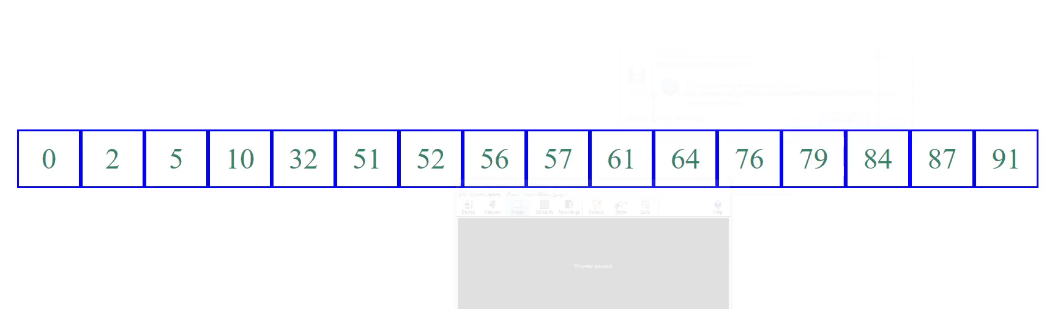
Binary Search example3 (Animation)

Slide 35
Binary Search
The basic steps to perform Binary Search are:
1. Sort the array in ascending order.
2. Set the low index to the first element of the array and the high index to the last element.
3. Set the middle index to the average of the low and high indices.
4. compare target element with middle element. If the element at the middle index is the target element, return the middle index.
5. If the target element is less than the element at the middle index, set the high index to the middle index – 1.
6. If the target element is greater than the element at the middle index, set the low index to the middle index + 1.
7. Repeat steps 3-6 until the element is found or it is clear that the element is not present in the array.

Slide 36
Binary Search
import java.util.Scanner;
public class BinarySearchDemo {
public static void main(String[] args) {
int[] myArray
= {2,3,5,6,8,9,11,18,29,65};
Scanner sc = new Scanner(System.in);
System.out.println
("Enter number to search");
int searchNumber = sc.nextInt();
int low = 0;
int high = myArray.length - 1;
boolean isFound = false;
while(high>=low) {
int mid = (high + low) / 2 ;
if(searchNumber == myArray[mid]) {
System.out.println("Found at = "+mid);
isFound = true;
break;
}
else if(searchNumber < myArray[mid]) {
high = mid - 1;
}
else {
low = mid + 1;
}
}
if(isFound==false) {
System.out.println
("Number does not exist in array");
}
}
}

Slide 37
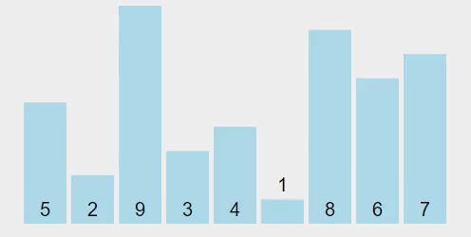
Sorting Array
Sorting, like searching, is a common task in computer programming. Many different algorithms have been developed for sorting.
There are many sorting techniques available, we are going to explore selection sort.
Selection sort
finds the smallest number in the list and swaps it with the first element.
It then finds the smallest number remaining and swaps it with the second element, and so on, until only a single number remains.

Slide 38
Selection Sort (Example)
int a[] = { 5, 2, 9, 3, 4, 1, 8, 6, 7 };
for (int i = 0; i < a.length - 1; i++) {
// Find the minimum in the list[i..a.length-1]
int currentMin = a[i];
int currentMinIndex = i;
for (int j = i + 1; j < a.length; j++) {
if (currentMin > a[j]) {
currentMin = a[j];
currentMinIndex = j;
}
}
// Swap a[i] with a[currentMinIndex] if necessary
if (currentMinIndex != i) {
a[currentMinIndex] = a[i];
a[i] = currentMin;
}
}
for(int temp: a) { // this is foreach loop
System.out.print(temp + ", ");
}

Slide 39
For-each loop
For-each is another array traversing technique like for loop, while loop, do-while loop introduced in Java.
It starts with the keyword for like a normal for-loop.
Instead of declaring and initializing a loop counter variable, you declare a variable that is the same type as the base type of the array, followed by a colon, which is then followed by the array name.
In the loop body, you can use the loop variable you created rather than using an indexed array element.
It’s commonly used to iterate over an array or a Collections class.
Syntax:
for(type var:array)
{
statement using var;
}

Slide 40
Sample program using for-each
//code will print all array elements
public class Easy {
public static void main(String[] args)
{
int ar[]={10,50,60,80,90};
for(int element:ar)
System.out.println(element);
}
}
//same code using simple for loop:
public class Easy {
public static void main(String[] args)
{
int ar[]={10,50,60,80,90};
for (int i = 0; i < a.length; i++)
{
int element=ar[i];
System.out.println(element);
}
}

Slide 41

Object-Oriented Programming using Java
#2104CS203
Thank You
Prof. Devangi L. Kotak
Darshan Institute of Computer Application
Darshan University, Rajkot
devangi.kotak@darshan.ac.in

